Slide 1
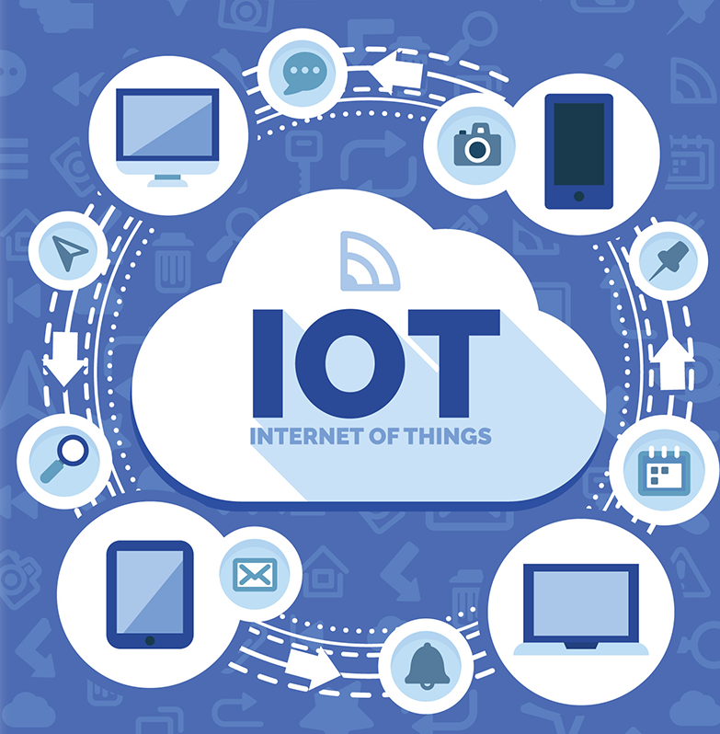
IOT Workshop Day-2
Organised by KURC in association with KUCC

Slide 2
Course Outline
Node MCU basics
Sensors and Data Fetching
Wi-fi and IOT
3rd Party Applications
IOT Project

Slide 3
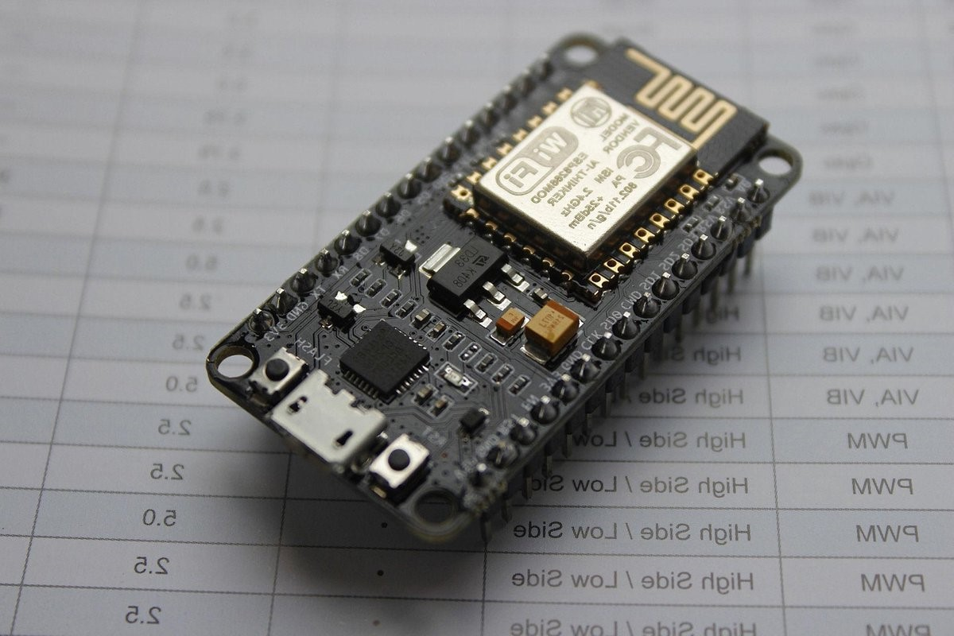
Brief introduction of the Internet
1960s- ARPANET
Initiated by the U.S. Department of Defense’s Advanced Research Projects Agency (ARPA).
1970s- Protocols and Expansion
Development of TCP/IP protocols by Vint Cerf and Bob Kahn in 1974
TCP/IP became the standard networking protocol in 1983.
Tim Berners-Lee developed the World Wide Web at CERN in 1989-1990.
2010s: Mobile Internet and IoT
2020s: 5G and Beyond
Introduction
Protocols
Application
Course plan

Slide 4
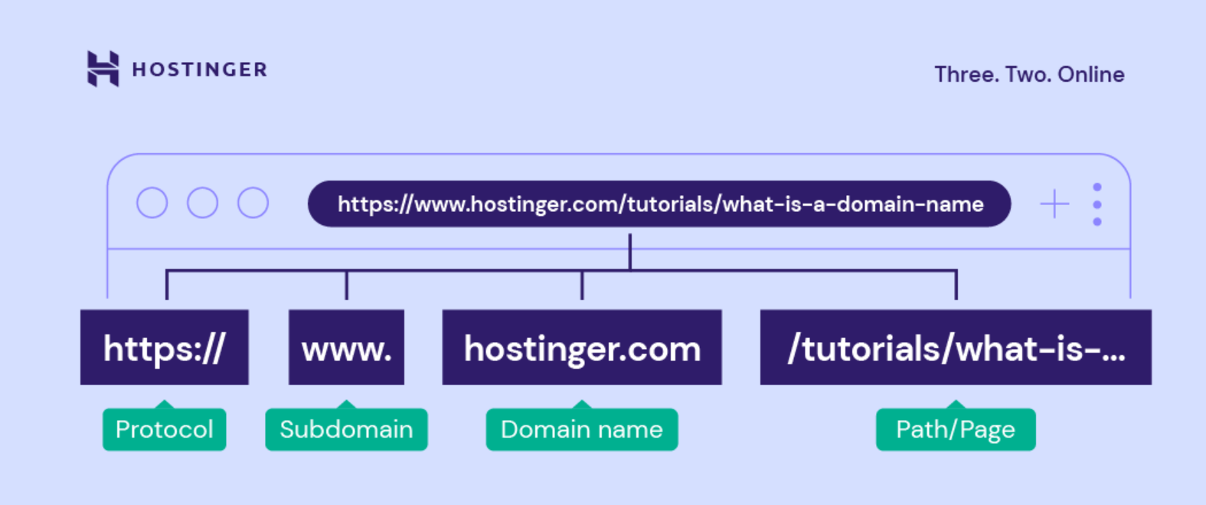
URL structure
Protocol (Scheme) communication protocols between web servers and web browsers.
A subdomain consists of any words or phrases that come before a URL’s first dot. Referring to the world wide web, www is the most common type.
A domain name is what users type into their browser’s address bar to reach a website.
Path is inherent to the website.

Slide 5


Communication Protocols
HTTP/HTTPS
- Suited for secure, reliable web communications, particularly where strong security is required, and resource constraints are less of an issue.
CoAP - Ideal for constrained devices and networks requiring lightweight, simple request/response communication with basic reliability.
MQTT -MQTT(Message Queuing Telemetry Transport) is designed to be extremely lightweight both in terms of bandwidth usage and client implementation.
Protocols
Introduction
Application
Course plan

Slide 6
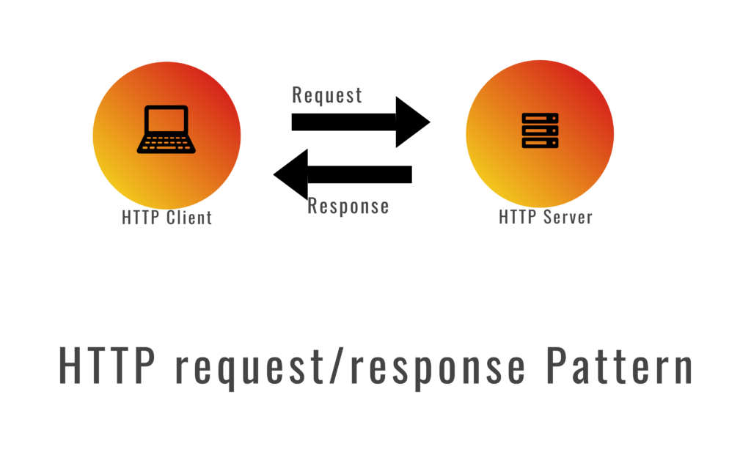
Https Vs MQTT
Model: HTTPS uses a synchronous request/response model, while MQTT(Message Queuing Telemetry Transport) uses an asynchronous publish/subscribe model.
Transport: Both use TCP(transmission control protocol), but HTTPS includes TLS(transport layer security) for built-in security, whereas MQTT can optionally use TLS.
Security: HTTPS inherently provides strong security features, whereas MQTT can be secured but does not include built-in security.
Overhead: HTTPS has higher overhead due to encryption and HTTP protocol elements, while MQTT is lightweight and optimized for low-bandwidth and high-latency environments.
Protocols
Introduction
Application
Course plan

Slide 7

Applications
Agriculture (Smart Farming)
Soil moisture sensors, automated irrigation systems, and livestock monitoring.
Transportation and Logistics
Fleet management systems, smart logistics, and real- time tracking.
Smart Homes
Automation and control of home systems such as lighting, heating, security, and appliances.
Healthcare (IoT in Medicine)
Remote monitoring and management of health conditions.
Application
Introduction
Protocols
Course plan

Slide 8
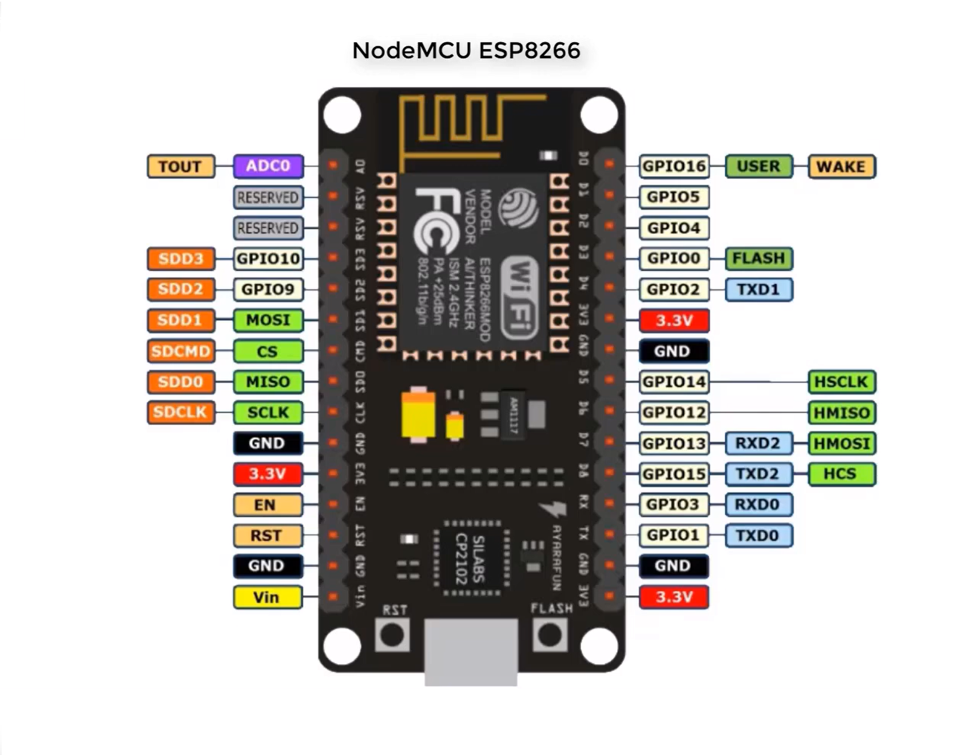
Datasheet ESP8266 -GPIO pins -3.3v -GND -Analog Pin -Reset and Flash -UART
Application
Introduction
Protocols
Course plan

Slide 9
Course plan
Create Bluetooth chatapp
Connect to Wi-Fi
Create basic web server
Display sensor data in webpage
Setup Blynk IOT
Led control Blynk
Course plan
Introduction
Protocols
Application

Slide 10
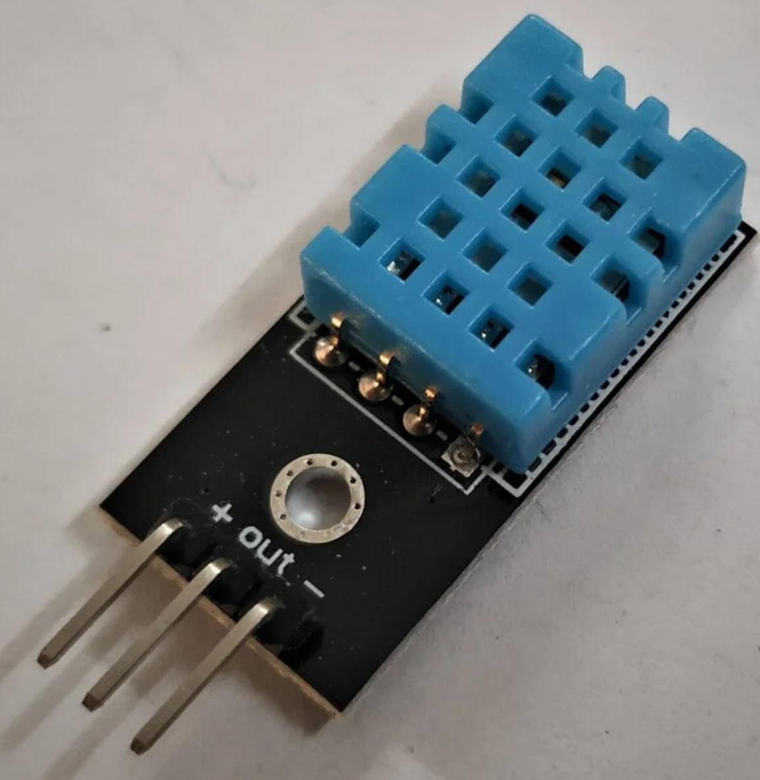
Temperature sensor
Temperature sensors are essential for a wide range of applications from industrial processes to consumer electronics. Understanding their working principles and types helps in selecting the right sensor for your specific needs.
Thermocouples (Seebeck effect)
RTDs (Resistance Temperature Detectors)
Thermistors*
Semiconductor Sensors

Slide 11
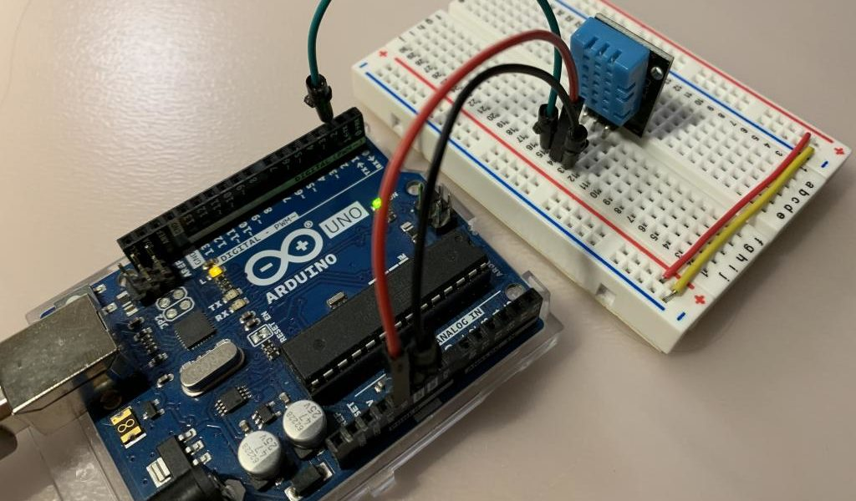
DHT11 sensor
The DHT11 uses a capacitive humidity sensor. It consists of two electrodes with a moisture-holding substrate between them. As the humidity changes, the conductivity of the substrate changes, affecting the capacitance between the electrodes.
The temperature sensor is a thermistor, a type of resistor whose resistance changes with temperature. It is typically a Negative Temperature Coefficient (NTC) thermistor, meaning its resistance decreases as the temperature increases.

Slide 12
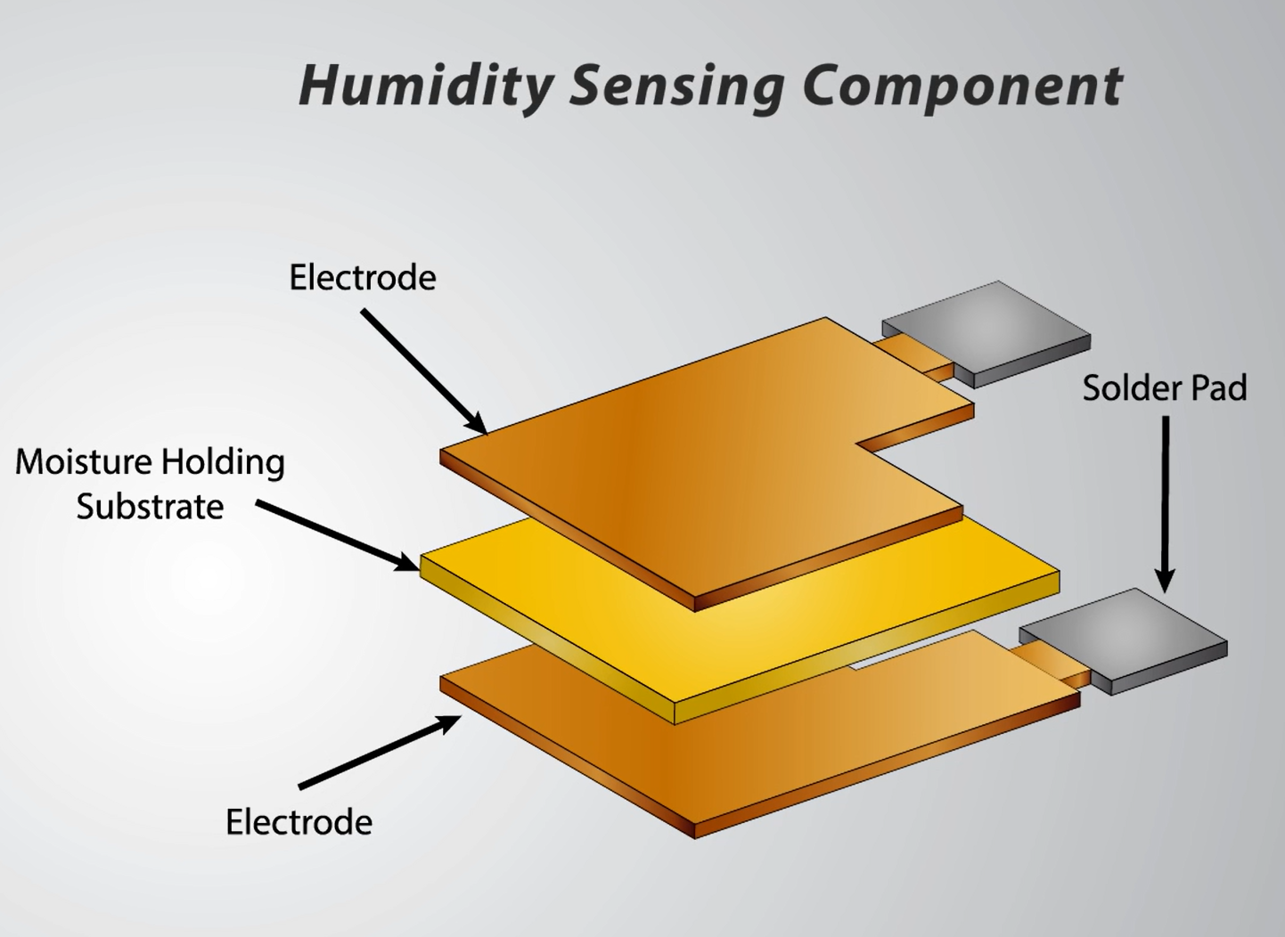
Humidity Sensor
The core component of the humidity sensor in the DHT11 is a capacitive element.
This element consists of two electrodes with a moisture-sensitive dielectric polymer layer between them. The polymer can absorb and release water vapor, altering its capacitance in response to changes in humidity.
As the relative humidity in the air changes, the dielectric constant of the polymer changes due to the absorption or desorption of water vapor. This alters the capacitance between the electrodes.

Slide 13
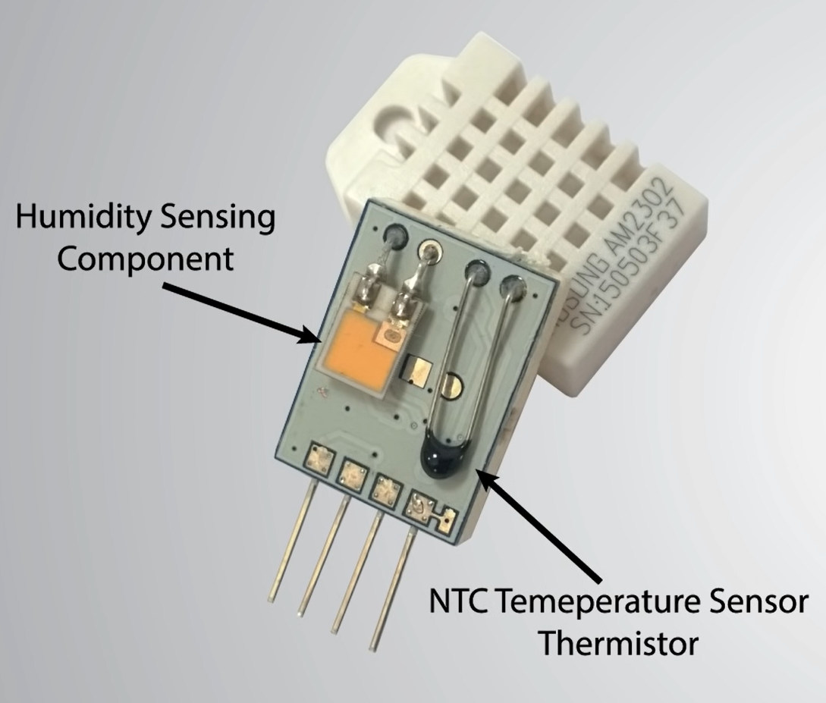
Temperature sensor
The DHT11 sensor uses Thermistor to measure temperature.
A thermistor is a type of resistor whose resistance varies significantly with temperature.
The DHT11 uses a Negative Temperature Coefficient (NTC) thermistor, which means its resistance decreases as the temperature increases.
This IC applies a known voltage across the thermistor and measures the current flowing through it, or it measures the voltage drop across a series resistor to determine the resistance of the thermistor.

Slide 14
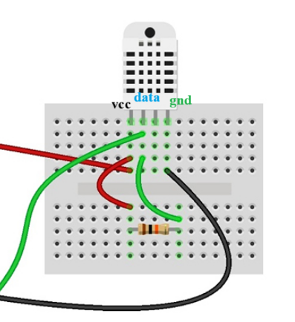
Circuit for dht11
Connect the dht11 with esp8266 as shown.
The VCC and data needs to be connected using a 10K ohm resistor.
Normally this would be done with a breakout board.

Slide 15
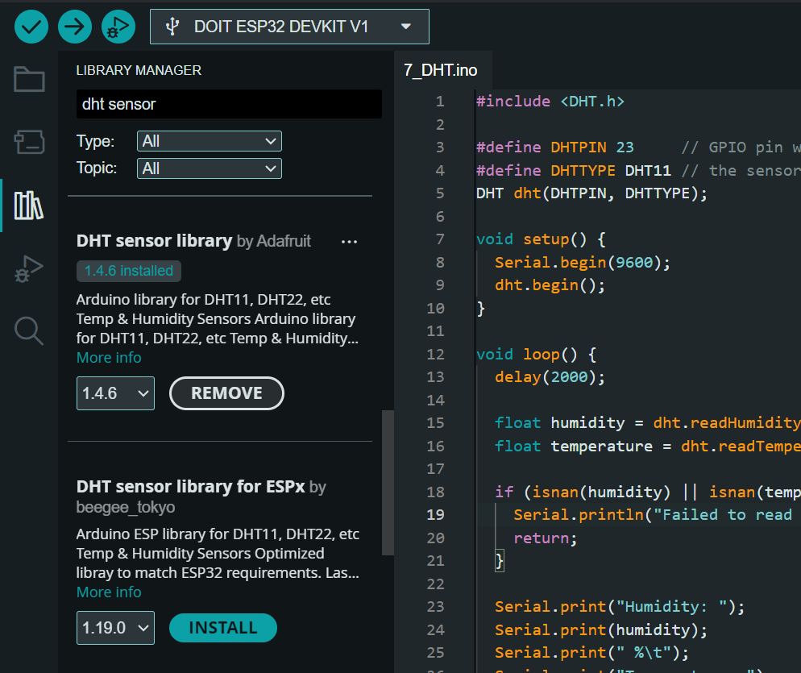
Installing DHT library
In the Library Manager window, you will see a search bar at the top right.
Type in DHT or DHT sensor library to search for the library.
Look for the library named DHT sensor library by Adafruit in the list of results.
Click on the Install button next to the library. The Library Manager will download and install the library.
If this doesn’t work you can manually install the library from GitHub.

Slide 16
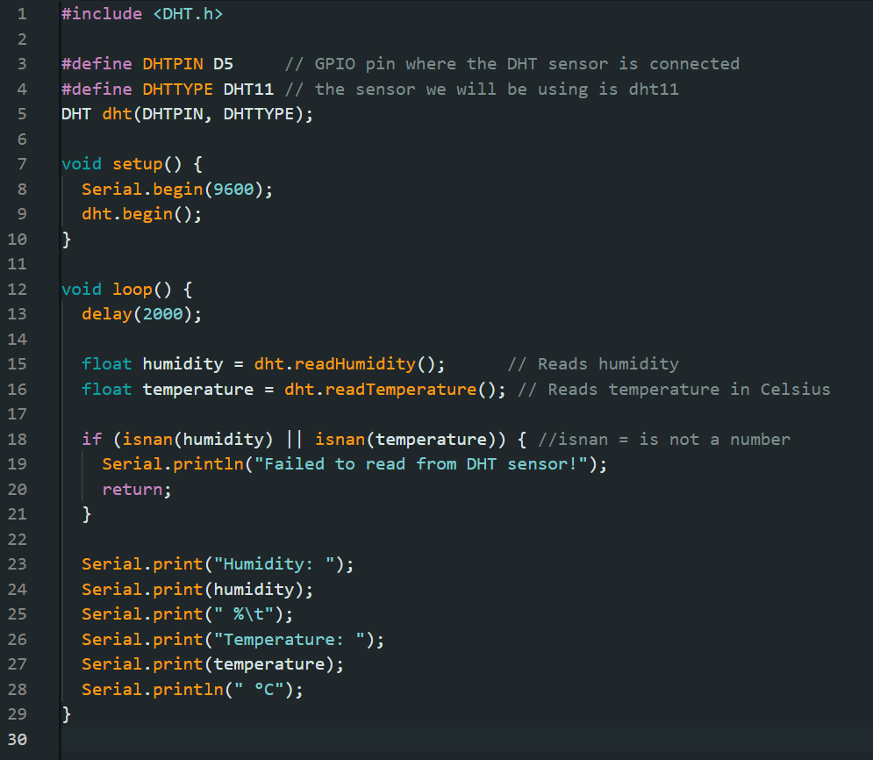
DHT Sensor
This code effectively demonstrates how to use a DHT sensor to measure temperature and humidity. By reading the information sent by the sensor, it can be displayed on the Serial Monitor.
Utilises DHT sensor library by Adafruit
Stores humidity in float humidity
Stores temperature in float temperature
Displays both in serial monitor every two second

Slide 17
IOT Workshop
Organised by KURC in collaboration with KUCC

Slide 18
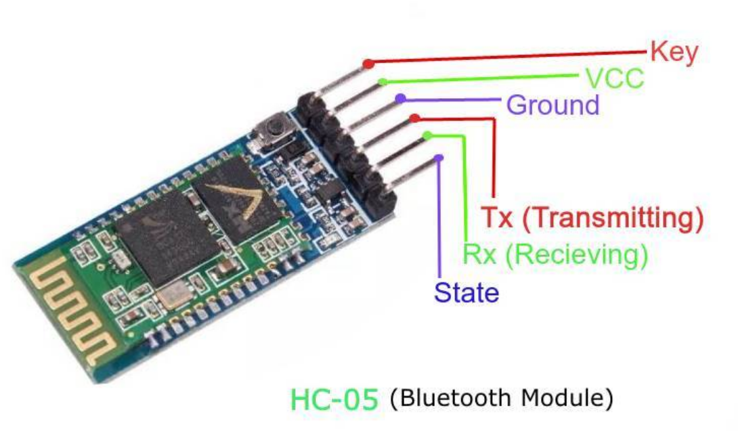
Steps:
Connect the Bluetooth Module to the Arduino:HC-05 TXD (Transmit) to Arduino D2 (Receive).
HC-05 RXD (Receive) to Arduino D3 (Transmit).
HC-05 VCC to Arduino 5V.HC-05 GND to Arduino GND.

Slide 19
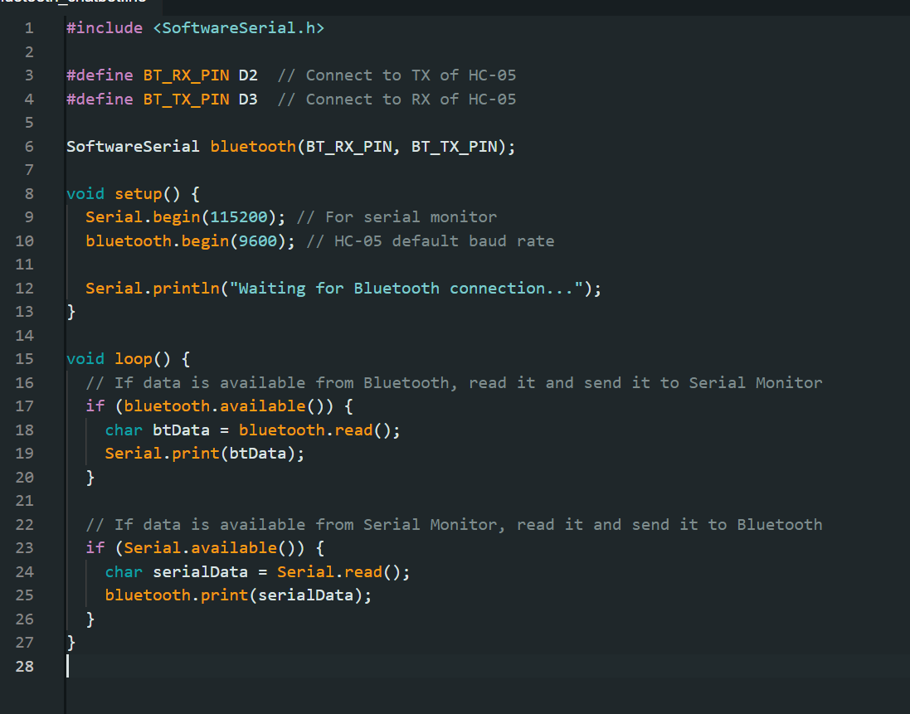
Bluetooth chatapp
SoftwareSerial library, which allows the Arduino to use additional serial ports for communication.
Serial.begin(115200);: Initializes the hardware serial communication at a baud rate of 115200. This is used for communication with the serial monitor on a computer.
bluetooth.begin(9600);: Initializes the SoftwareSerial communication with the Bluetooth module.
Serial.println("...");: Prints a message to the serial monitor indicating that the Arduino is waiting for a Bluetooth connection.

Slide 20
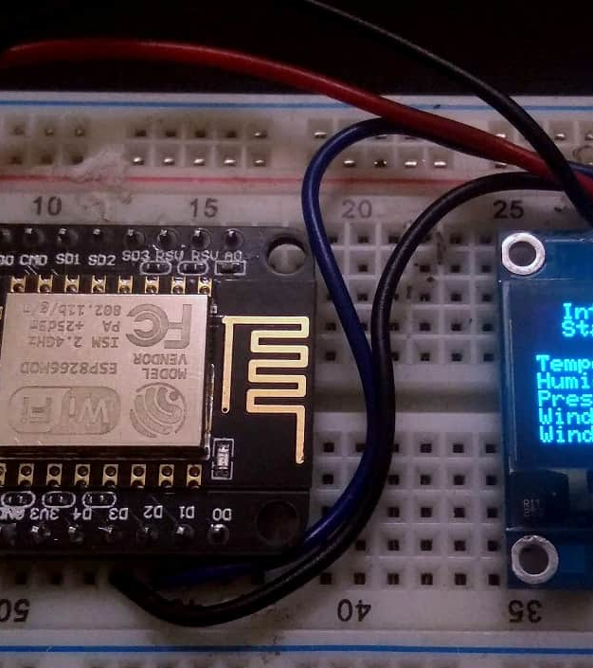
How it IOT works
The ESP8266 microcontroller facilitates IoT applications by collecting data from sensors, processing it locally, communicating over Wi-Fi using protocols like MQTT or HTTP, and interfacing with cloud platforms or local servers for data storage, analysis, and remote device control.
This enables the creation of efficient, scalable, and secure IoT solutions across different industries and use cases.

Slide 21
Steps to build a server
Connect to Wi-Fi
Sensors and Data Fetching
Start Webserver
Basic HTML and CSS
Handle Requests

Slide 22
Connecting to Wi-Fi
Connecting the ESP8266 microcontroller to Wi-Fi is a fundamental step in many IoT projects, as it enables the device to communicate with other devices or servers over the internet.
Here’s a detailed guide on how to connect the ESP8266 to Wi-Fi.

Slide 23
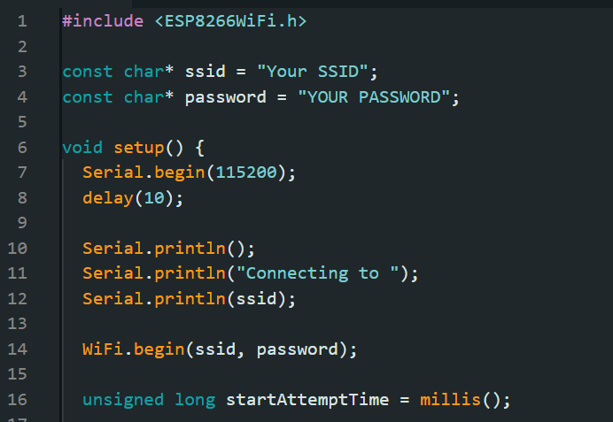
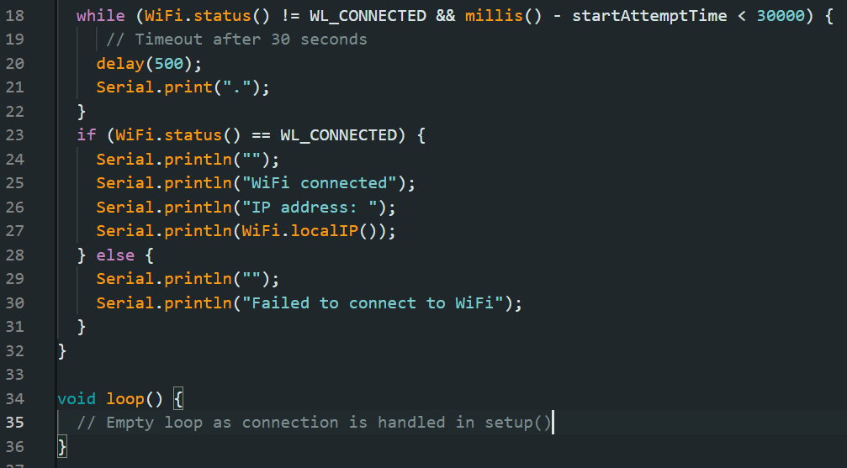
Enter credentials
Task1: connect to Wi-Fi
Write Connection logic

Slide 24
Display data in webserver
Using an ESP8266 module to collect sensor data and transmit it to a web server is a common scenario in IoT applications. The ESP8266 is a low-cost Wi-Fi module that can connect to Wi-Fi networks and communicate over the internet, making it ideal for sending sensor data to a remote server. Here’s a step-by-step guide on how to achieve this.

Slide 25
Steps to build a server
Connect to Wi-Fi
Sensors and Data Fetching
Start Webserver
Basic HTML and CSS
Handle Requests

Slide 26
What is HTML
HTML, or HyperText Markup Language, is the standard language used to create and design webpages. It structures content on the web by using a series of elements, which are represented by tags. Each tag serves a specific purpose, such as defining headings, paragraphs, links, images, and other types of content.
<!DOCTYPE html> declares the document type.<html> is the root element of an HTML page.
<head> contains meta-information about the document, like its title, which appears in the browser tab.
<body> contains the content of the webpage, including headings (<h1>), paragraphs (<p>), and links (<a>).

Slide 27
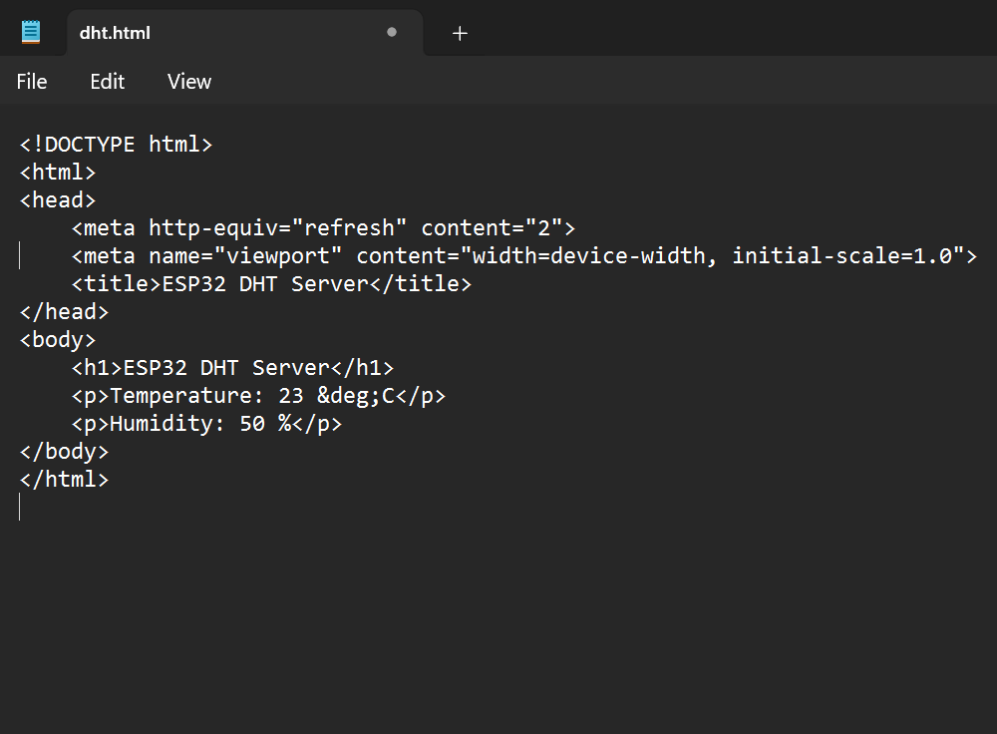
Basic HTML
In order to display the sensor data, we need a basic webpage.
You can build the webpage in any text editor, even notepad.
Just make sure to set the file extension to .html

Slide 28
Display DHTdata in webpage
We will be using the same functionality we wrote earlier to measure the temperature and humidity.
#include <ESP8266WebServer.h>: Includes the library to set up a web server.
server.on("/", handleRoot);: Defines the route and the function to handle the root URL ("/").
Use <meta http-equiv='refresh' content='2’> to refresh every two second
server.send(200, "text/html", html); Sends the constructed HTML page to the client.

Slide 29
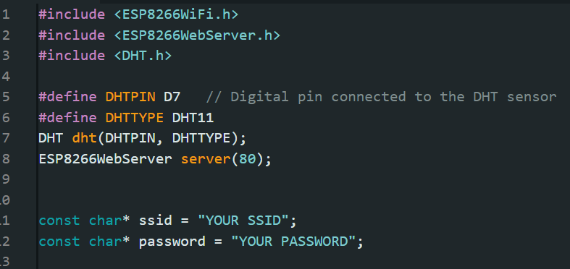
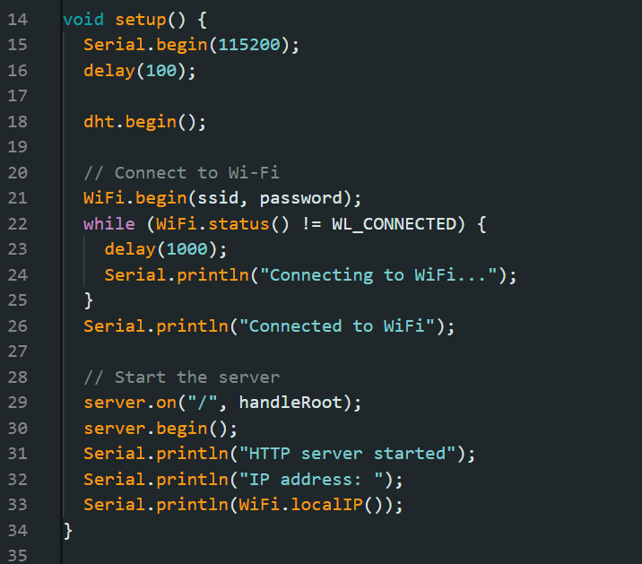
Setup variables and libraries
Task2:Display sensor data
Setup function

Slide 30
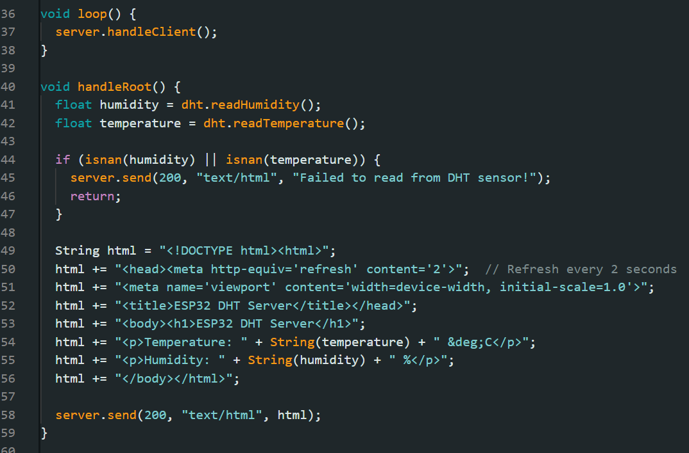
Format the html code in handleRoot()
Task2:Display sensor data
.

Slide 31
Creating basic web server
Creating a basic web server that controls an ESP8266 module via buttons involves setting up the ESP8266 to serve web pages and handle HTTP requests. This setup allows you to control GPIO pins (like turning on/off LEDs, relays, etc.) connected to the ESP8266 using a web interface.
Here’s a step-by-step guide to get you started

Slide 32
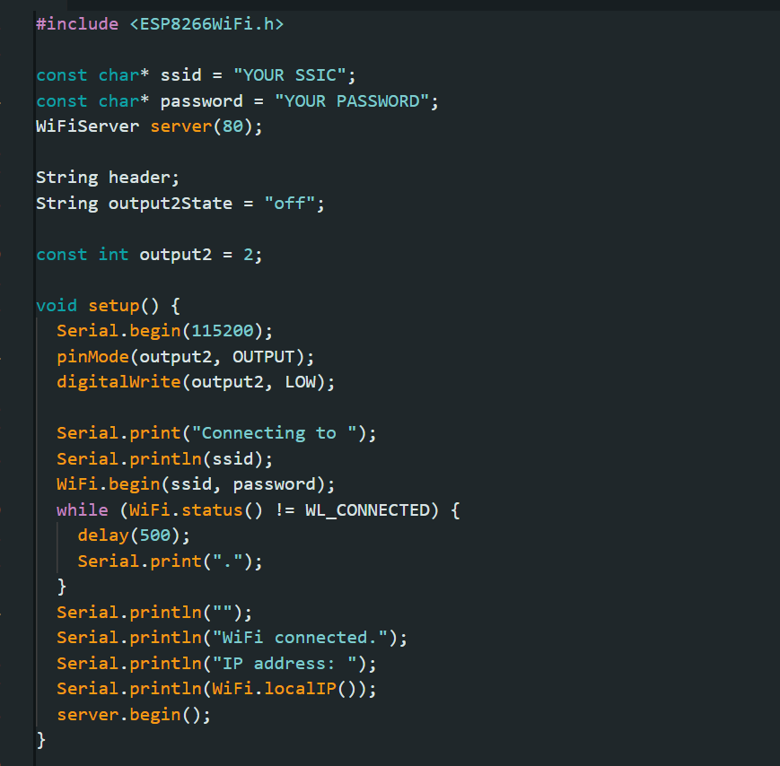
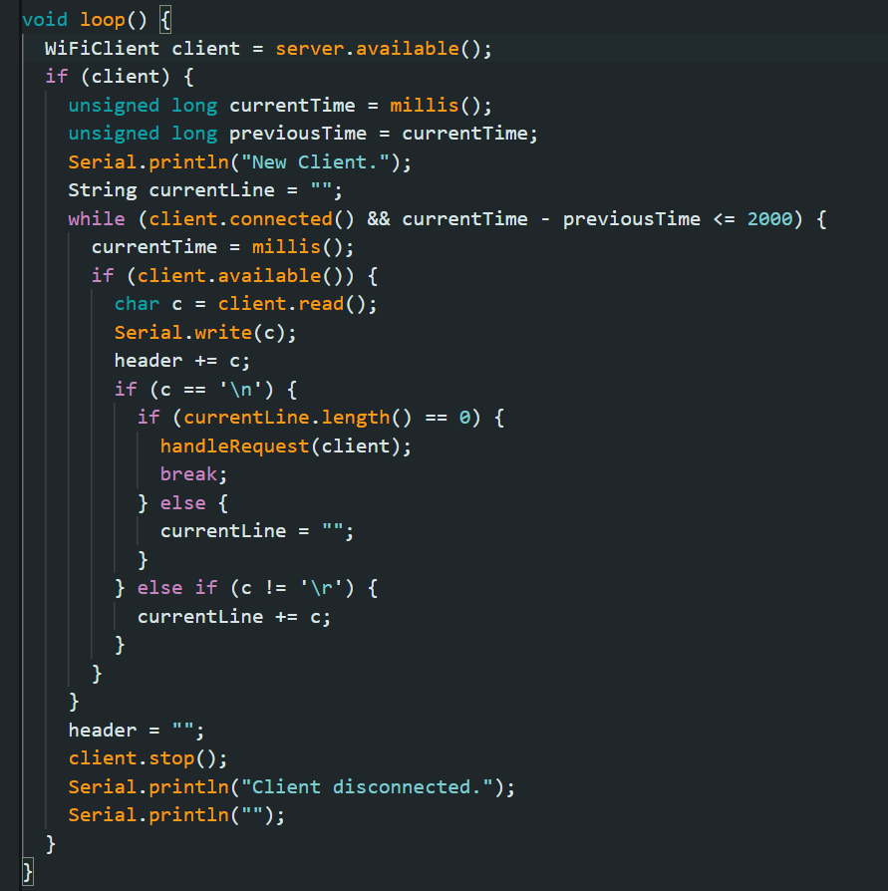
Setup
Task3 :Take user input
Loop function

Slide 33
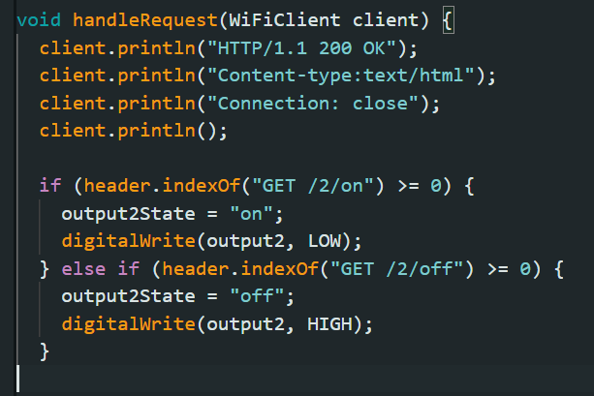
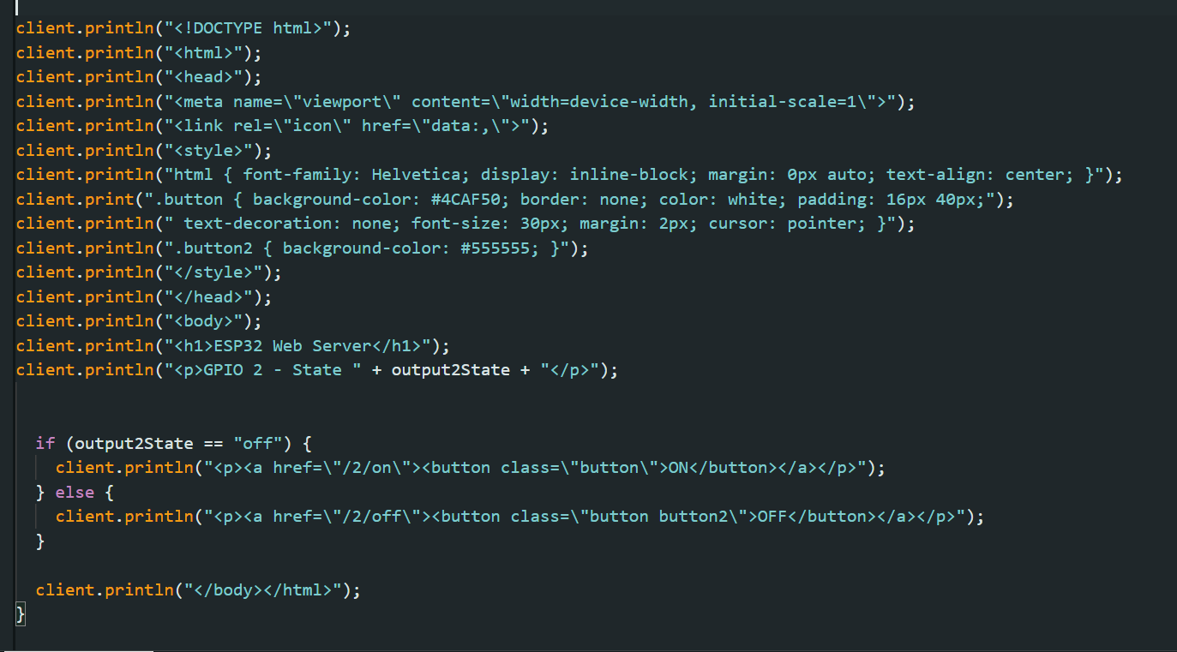
Handle request function
Task3 : Setup basic web server
Basic Html and CSS

Slide 34
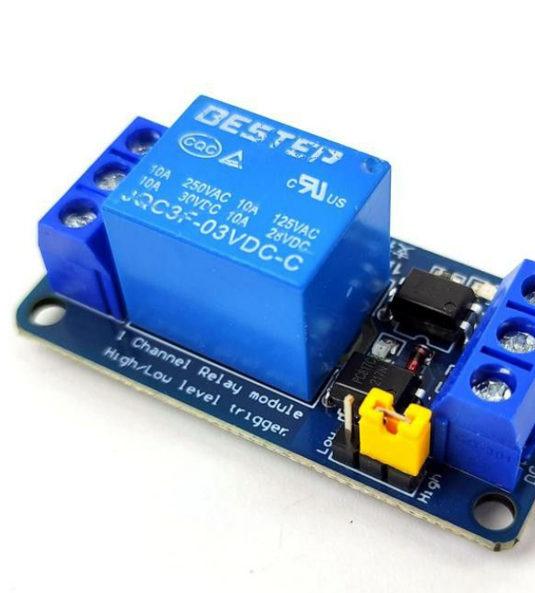
Relay
A relay is an electrically operated switch that uses an electromagnet to mechanically operate a set of contacts. It allows a low-power signal to control a high-power circuit, enabling safe and efficient control of electrical devices. Relays are commonly used in automation, industrial control systems, and electronic circuits where it's necessary to isolate the control signal from the high-power load.

Slide 35
End of Day 2
Organised by KURC in collaboration with KUCC

